Slide 1
Smart Network Switch
Group 9
Mahmoud Kharsa
Mark Bugaisen
David Nguyen

Slide 2
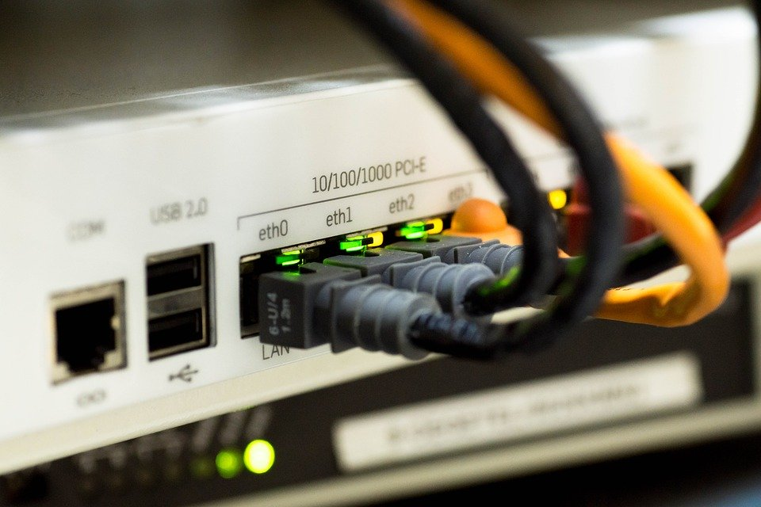
Project Overview
Forward network traffic to the right target
Done by building an address-port table

Slide 3
Requirements
FPGA routes packets to the correct destination device (in hardware)
Support two devices connected across Ethernet
Support one device connected across Wi-Fi
Support IPv4
Remotely configurable
Has monitoring capabilities from a PC connected across Ethernet
Minimum Throughput: 1 Mbps
Maximum Latency: 100 ms
✓
✓
~
✓
✓
✓
10 Mbps per port
✓
50 ms max bound case
✓

Slide 4
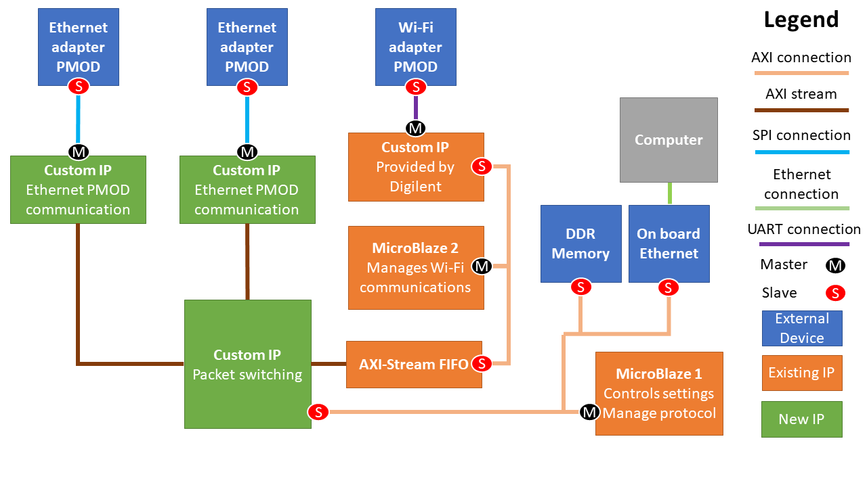
Block Diagram of Final System

Slide 5
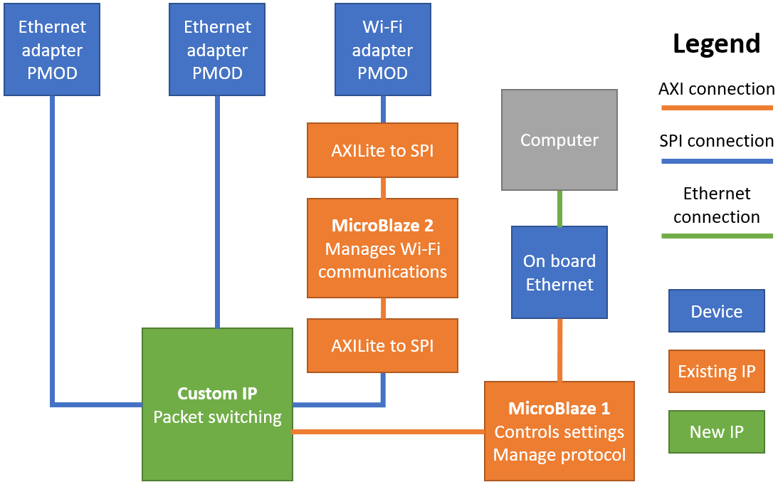
Block Diagram from Proposal

Slide 6
Block Diagram of Final System
Notes:
Discuss modification made vs proposed Block diagram (move to AXI Stream, added custom ip)
Problems faced: packet switching tvalid, tdata, tlast signals, endianness, Wi-Fi pmod only communicates using UDP and TCP, Wi-Fi microblaze DDR memory. Everything else went smoothly

Slide 7
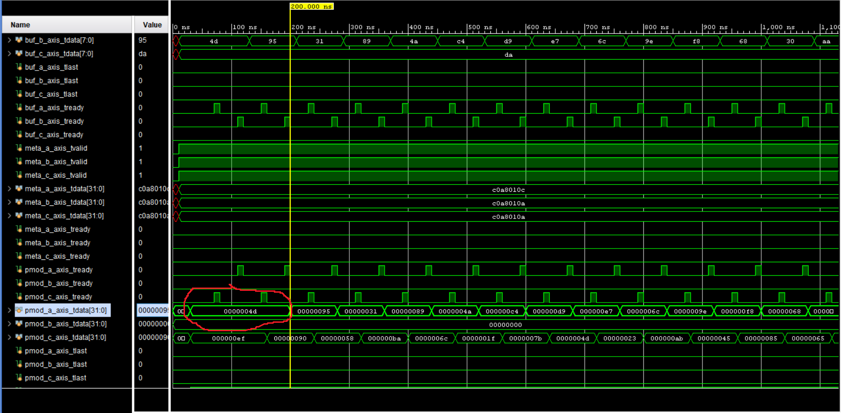
Challenges Encountered
The Wi-Fi only support UDP/TCP level communication
Only delivers packet content, no headers.
Wi-Fi microblaze DDR memory
Endianness
Packet switching tvalid, tdata, tlast signals

Slide 8
Custom IPs created (Hardware)
Packet Switcher IP (Custom IP)
Designed entirely from scratch, utilizes AXI Stream Data FIFOs
Interfaces with AXI Stream (two for each port) and AXI Lite (remote config)
Extracts metadata (ARP, IPv4, IP address)
Drops unknown packets
Directs traffic across three ports in round robin
NIC100 PMOD AXI Stream IP (Custom IP)
Based off a git implementation (https://github.com/carljohnsen/Pmod-NIC100)
Modified to interface with AXI Stream
Added additional commands for initializing PMOD in promiscuous mode

Slide 9
Source Code created (Software)
Wi-Fi PMOD Microblaze 2 code (ESP32)
Based off a git implementation https://github.com/Digilent/vivado-library/tree/master/ip/Pmods/PmodESP32_v1_0/
Modified to relay packets between the PMOD and the AXI Stream interface to the Packet Switcher IP
LWIP Server for Remote configuration over onboard Ethernet
Modified echo.c to accept commands (iptable -l, iptable -s, status)
Client Python script for issuing commands to LWIP Server
Python scripts for removing/adding UDP wrappers (Wi-Fi connected device)

Slide 10
Overall Design Process
Overall project was split into different modules and divided amongst us
At the start, David did the Wi-Fi, Mark did the Ethernet, Mahmoud did the custom IP
At the end, David did the Wi-Fi, Mark did integration, Mahmoud did the remote config.
Ensured that at any point in time, each person was doing something
Thorough Unit-Testing of modules
Simulation used to validate the packet switching IP
ILAs/debug print statements from the Microblaze used to validate the PMODs
Helped catch many bugs early on in the project before the final integration

Slide 11
What We Learned...
How a basic router works and how it is implemented in hardware
For the people in the team that haven’t taken Computer Networks…
How UDP communication works
How to use Wireshark to view incoming packets
Not to underestimate integration....
Initially proposed 1-2 spare weeks for integration, ended up using ALL of that time
Stresses the importance of unit-testing to catch bugs early on
ILAs were very helpful in isolating and root-causing bugs

Slide 12
NOW FOR THE
FINAL DEMO!

